Slide 1


Part 2: Training
Dr Ronald Clark
Martin Piala

Slide 2
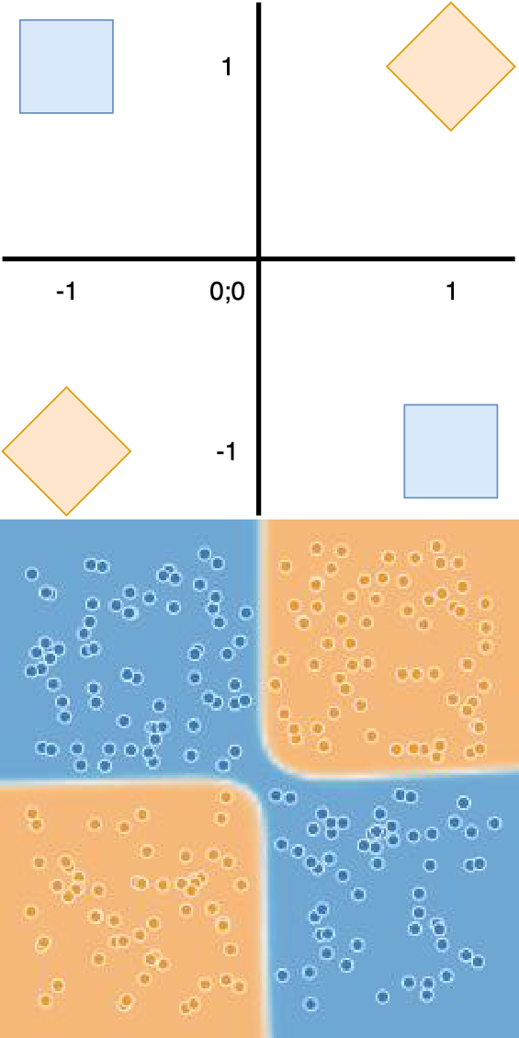
Deep Network Training
Yesterday’s setup:
Setup: Boolean inputs, XOR function.
Shallow model can’t fit the function.
Two layer NN can by composing it from AND, OR and NOT.
A real-valued extension
Real valued x and y.
More representative of real problems.
https://playground.tensorflow.org

Slide 3
Outline for Today
Training data
Loss function
The training loop
Model update
Gradient descent
Backward pass
Computing gradients

Slide 4
Training Data
The data at hand needs to be split in three groups:
[80%] Training set
Models are optimized for performance on it.
The information is encoded in the model.
[10%] Validation set
Used for choosing hyperparameters.
We use it to assess the out of sample performance of the candidates.
[10%] Test set
Is used for evaluating performance.

Slide 5
Loss functions
Accuracy and confidence.
Confidence in a classification prediction is crucial too.
Take a setup with 4 classes, the first is the correct class.
Model A outputs Model B outputs
[1.00, 0.00, 0.00, 0.00]
[0.30, 0.25, 0.25, 0.20]
Model A is preferred as it is much more confident in its answer, and this is
correct. Model B took almost uniform view of the input’s class.
Any data-centric or task-specific concerns:
Small datasets are often compensated for by the inclusion of regularization
Biased datasets are compensated for by penalizing the undesirable bias in the model’s performance. This is used when data contains racial, gender, or other bias.

Slide 6
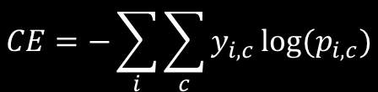
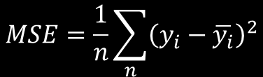
Loss Function
Any differentiable function can be used.
The common and popular choices are:
$$MSE=\frac{1}{n}\sum_{n}{{\left(y_{i}−\overline{y_{i}}\right)}^{2}}$$
Mean Squared Error:
As seen in ordinary least squares regression.
It is the average of the squared distances between the 𝑛 ground truths and the associated model’s predictions
Cross-Entropy Loss:
$$CE=−\sum_{i}{\sum_{c}{y_{i,c}}log⁡(p_{i,c}})$$
As seen in logistic regression under maximum likelihood (ML).
Chiefly used in classification.
It is many things to many people, to us it is grounded in the ML.

Slide 7
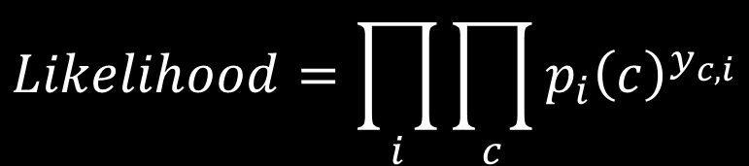
Relation to Log-likelihood
Given the predicted probabilities, the likelihood of the sequence is:
$$Likelihood=\prod_{i}{\prod_{c}{p_{i}{\left(c\right)}^{y_{c,i}}}}$$
Maximum likelihood optimizes this term

Slide 8
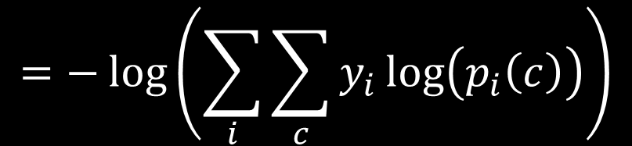
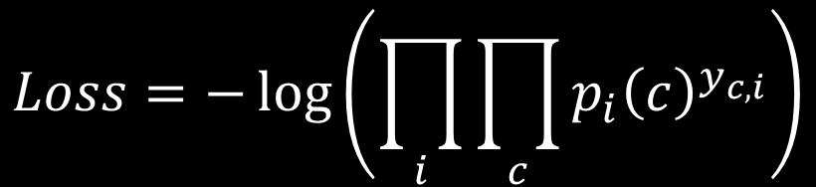
Log-likelihood
Maximum remains unchanged by logarithm. Thus we obtain out loss function:
$$Loss=−\log\left(\prod_{i}{\prod_{c}{p_{i}{\left(c\right)}^{y_{c,i}}}}\right)$$
$$=−\log\left(\sum_{i}{\sum_{c}{y_{i}\log\left(p_{i}\left(c\right)\right)}}\right)$$
This is for numerical stability.

Slide 9
Cross-entropy
It is convenient.
It has superior gradient stability, and computational properties when combined with softmax output.
It has a good empirical performance.
Empirically it has superior performance on real-world tasks.
It has a long tradition in machine learning.
Prior to DL, cross-entropy loss was implied in maximum likelihood estimators of logistic regression.

Slide 10
How is the loss used?
Minimize the loss
Ideally, we would like to do this in one shot.
E.g. the closed form solution to least-squares regression:
𝛽 =𝑋^{𝑇}𝑋
−1_{𝑋}𝑇_{𝑌}
In deep learning, there is no closed form so we have to iteratively minimize the loss.

Slide 11
Loss visualization
Before minimizing the loss we should know its properties.
Loss surface captures the loss value across the parameter space.
The loss surface # 𝑝𝑎𝑟𝑎𝑚𝑒𝑡𝑒𝑟𝑠+1 dimensional.
A model with two parameters 𝜃 would have loss surface in 3 dimensions.
High dimensional surfaces cannot be visualized

Slide 12
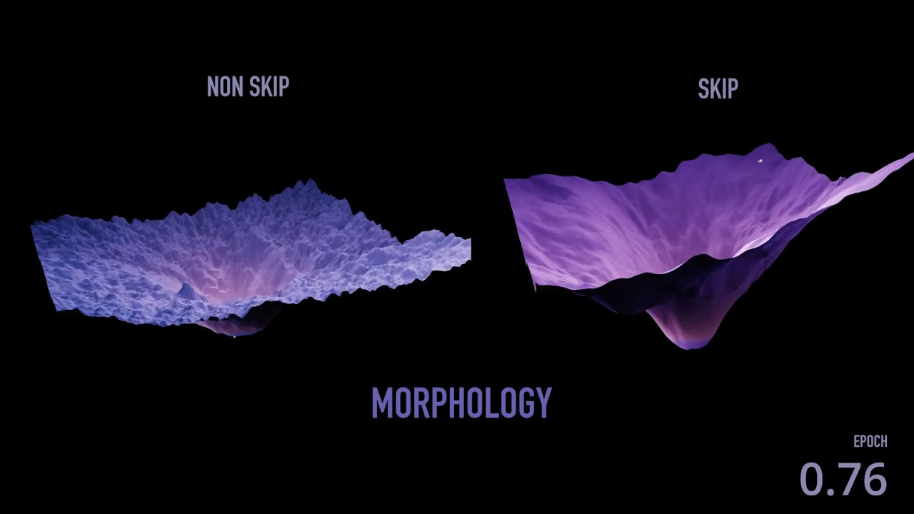
Loss visualization
Moving Lands | Video visualizations of A.I training morphology & dynamics (losslandscape.com)

Slide 13
Loss function summary
Common functional forms are:
Mean Squared Error
Cross-Entropy Loss
We minimize the loss to find best model.
Loss surface visualizations are deceiving – 3D does not do justice to the 1M+ dimensional original.

Slide 14
Overview of Training
This involves two aspects:
Model update
Computing gradients
how to incrementally improve model.
how to compute the ingredients.
Then we will look into the gradient specificities of:
Fully connected layer
Convolutional layer
Pooling layer
Recurrent layer
the baseline case
image weight sharing
the case of no parameters
sequence-implied weight sharing

Slide 15
Model Update
We aim to minimize the loss function.
This corresponds to finding a minimum in the loss surface.
We lack a closed form solution.
Thus we need to resort to an iterative method of gradually improving a given model till it reaches the minimum.
The iterative method needs a starting point.
Unless we have a good starting point provided to us (meta learning) the best we can get is a reasonable random initialization.

Slide 16
Model Update
From the random initialization our method needs to find a way downhill.
Optimizer can:
adjust trainable parameters.
retrieve model’s predictions.
compute loss and accuracy.
retrieve loss function (with NN parameters plugged-in).
Optimization does not:
see the loss surface.

Slide 17
Model Update
Our situation is similar to trying to find a downward path
from a mountain with one’s eyes closed shut:
We can take short steps.
We can get an altitude reading.
We can get the direction of the steepest fall.
We can not see the full picture of the landscape ahead of us.

Slide 18
Model Update
Minimize loss through Gradient descent
Formally: 𝜃^{𝑠+1} = 𝜃^{𝑠} − 𝑟 ∙ 𝑔^{𝑠}
𝑙,𝑖 𝑙,𝑖 𝑙,𝑖
Each update is a step, once all examples were used an epoch has passed
Repetitively taking a small step in the most downhill direction.
The most downhill direction is defined as the negative of the loss function’s gradient.

Slide 19
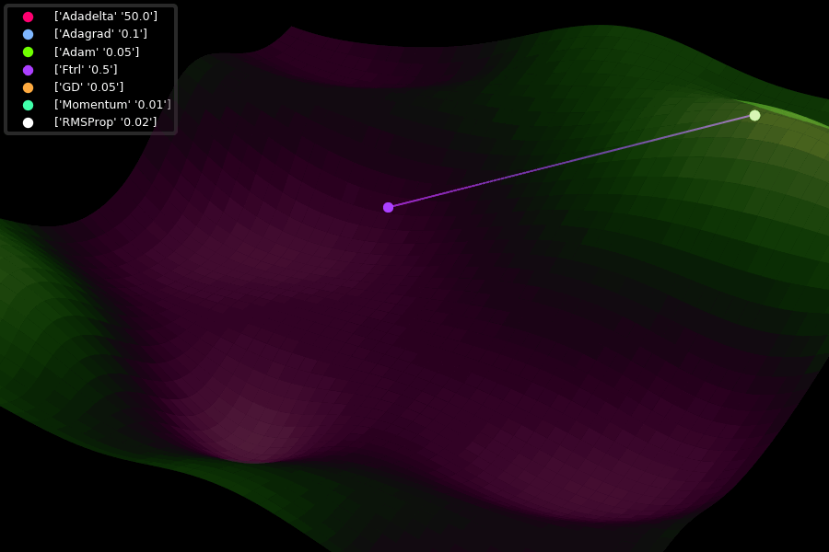
Model Update
GitHub - Jaewan-Yun/optimizer-visualization: Visualize Tensorflow's optimizers.

Slide 20
Model Update
At the layer 𝑙 any parameter 𝑖 is updated at step 𝑠 like so:
_{𝑤}𝑠+1 _{= 𝑤}𝑠
− 𝑟 ∙ 𝑔^{𝑠}
Weights:
Biases:
𝑙,𝑖 𝑙,𝑖
𝑙,𝑖
_{𝑏}𝑠+1 _{= 𝑏}𝑠
− 𝑟 ∙ 𝑔^{𝑠}
𝑙,𝑖 𝑙,𝑖 𝑙,𝑖
Generally the same holds for any parameter 𝜃:
_{𝜃}𝑠+1
= 𝜃_{𝑙,𝑖} − 𝑟 ∙ 𝑔_{𝑙,𝑖}
gradient
𝑠 𝑠
step size
𝑙,𝑖

Slide 21
Model Update Summary
In the absence of a closed form solution iterative improvements starting at a random initialization are the best we can do (given the field’s development).
The process involves finding the most downward direction and taking a small step in that direction.
𝜃^{𝑠+1} = 𝜃^{𝑠} − 𝑟 ∙ 𝑔^{𝑠}
𝑙,𝑖 𝑙,𝑖 𝑙,𝑖
We will get into the details of how the length of that step should be determined tomorrow.
Before we do that, we need to finish the discussion of training.

Slide 22
SGD and Batches
The gradient is defined on the entire training set.
This can be very expensive. Consists of a sum of gradients of the individual training examples. In ImageNet1.5M individual gradients to sum.
Solved by Stochastic Gradient Descent (SGD).
Gradients are estimated based on batch of the full training set. This has the desirable property of decreasing the memory constraint of our model. Noise is also beneficial.

Slide 23





Training Loop
Start a new epoch
Shuffle data
Training
Structured into epochs
Epoch
One pass of all train examples through the NN.
Step
EPOCH
Train
Keep drawing batches until all train examples were used.
Forward Pass
For all layers:
compute node value
save node value
pass node value
Take a batch
STEP
One forward pass, one backward pass.
Parameter update.
Backward Pass
For all layers:
evaluate parameter gradient
perform update
evaluate layer gradient
pass layer gradient

Slide 24
Training Loop in PyTorch
def main(net, numEpoch, use_cuda=False, lr=0.1):
# Create Dataset loaders
trainLoader, testLoader = utils.getMNISTdataset()
# Generate a summary writer
writer = misc.createTensorBoardWriter('./results/p02/' + net.name + '/lr' + str(lr))
# Define optimiser
optim = torch.optim.SGD(net.parameters(), lr=lr)
# Define where training/testing will take place
device = torch.device("cuda" if use_cuda else "cpu")
print("Launching training on: %s" % device)
# Send model to device
net = net.to(device)
# Train for `numEpoch` epochs
n_iter = 0 # used as batch id for Tensorboard visualisations
for epoch in range(1, numEpoch + 1):
n_iter = train(net, device, trainLoader, writer, optim, epoch, n_iter)
# Evaluate on test set
test(net, device, testLoader, writer)
Training loop

Slide 25
Training Loop in PyTorch
def train(model, device, train_loader, writer, optimiser, epoch, n_iter, vizStep=100, logStep=25):
model.train()
# for every mini-batch containing batch_size images...
with tqdm(total=len(train_loader.dataset), desc='Train Epoch #' + str(epoch)) as t:
for i , (data, target) in enumerate(train_loader):
inputs, labels = data.to(device), target.to(device)
# zero gradients from previous step
optimiser.zero_grad()
# this executes the forward() method in the model
outputs = model(inputs)
# compute loss
loss = model.criterion(outputs, labels)
# backward pass
loss.backward()
# evaluate trainable parameters
optimiser.step()
n_iter += inputs.shape[0]
return
Gradient computation
Parameter update

Slide 26
Outline for Today
Training data
Loss function
The training loop
Model update
Gradient descent
Backward pass
Computing gradients

Slide 27
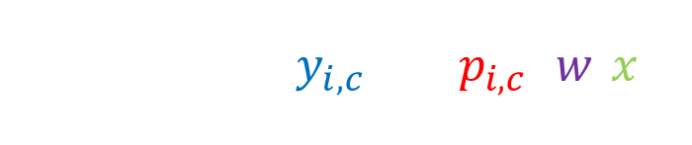
Computing Gradients
$$L=−\sum_{i}{\sum_{c}{y_{i,c}}log⁡(p_{i,c}}(w,x))$$
The targets depend on data labels while the predictions depend on data inputs and model parameters.
Data and hyperparameters are considered constants.
Gradients are computed only for trainable parameters.
Thus, each gradient evaluation is based on:
The functional form of the equation
The train set targets used
The values of the trainable parameters

Slide 28
Computing Gradients
Gradient is the partial derivatives of the loss function with
respect to all of the NN’s trainable parameters.
(Partial) derivative is defined as:
𝑑𝑓 θ, 𝑥 𝑓 θ, 𝑥 + Δ𝑥 − 𝑓 θ, 𝑥
= 𝑙𝑖𝑚_{Δ𝑥→0}
𝑑𝑥 Δ𝑥
in other words, it is the difference between two evaluations of the function, as the distance between the points at which these are performed tends in limit to zero. The derivative is taken with respect to the parameter x, while the other parameters θ remain constant.

Slide 29
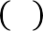
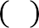
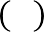
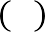
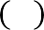
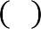
Computing Gradients
Derivatives of complicated functions are built up from
primitives and simple rules
Exponential
Logarithm
Sine, Cosine, Tan.
Power rule
Sum rule
Product rule
Chain rule
^{𝑑𝑎𝑥} = 𝑙𝑛 𝑎 ∙ 𝑎^{𝑥}
𝑑𝑥
𝑑𝑙𝑜𝑔_{𝑎} 𝑥 1
=
𝑑𝑥 𝑥∙𝑙𝑛 𝑎
see mathematical tables…
𝑑 𝑥^{𝑛}
= 𝑛 ∙ 𝑥^{𝑛−1}
𝑑𝑥
𝒅 𝒂+𝒃 ₌ 𝒅 𝒂 ₊ 𝒅 𝒃
𝒅𝒙 𝒅𝒙 𝒅𝒙
𝑑 𝑎×𝑏 ₌ 𝑑 𝑎
∙ 𝑏 + ^{𝑑 𝑏} ∙ 𝑎
𝑑𝑥 𝑑𝑥 𝑑𝑥
NN frameworks handle these in the background.

Slide 30
Sum rule
The sum rule:
𝑑 ∑ 𝑎_{𝑖} 𝑑 𝑎_{𝑖}
= ∑
𝑑𝑥 𝑑𝑥
The intuition:
For each infinitesimal change in any of the input terms, the final sum will change by the same amount.

Slide 31
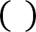
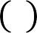
Chain Rule
Setup:
𝑓 is a function of 𝑔 which itself is a function of 𝑥. We seek the derivative of 𝑓 with respect to 𝑥
Formally:
𝑑𝑓 𝑑𝑓 𝑑𝑔
= ×
𝑑𝑥 𝑑𝑔 𝑑𝑥
The intuition:
Since 𝑓 depends on g and g depends on 𝑥, the rate of change of 𝑓 w.r.t 𝑥 depends on both 𝑓 w.r.t 𝑔 and 𝑔 w.r.t 𝑥

Slide 32
Chain Rule
Output layer 𝑂 with parameters 𝜃_{𝑂}, hidden layer 𝐻 with 𝜃_{𝐻}, and input layer 𝐼 with parameters 𝜃_{𝐼}. And a loss function 𝐿. The loss gradients with respect to parameters:
Input layer
𝑑𝐿 ₌ 𝒅𝑳 𝒅𝑶 𝒅𝑯 𝑑𝐼
𝑑𝜃_{𝐼} 𝒅𝑶 𝒅𝑯 𝒅𝑰 𝑑𝜃_{𝐼}
𝑑𝐿 ₌ 𝒅𝑳 𝒅𝑶 𝑑𝐻
Hidden layer
𝑑𝜃_{𝐻} 𝒅𝑶 𝒅𝑯 𝑑𝜃_{𝐻}
Output layer
𝑑𝐿 ₌ 𝒅𝑳
𝑑𝑂
𝑑𝜃_{𝑂} 𝒅𝑶 𝑑𝜃_{𝑂}

Slide 33
Chain Rule
Input layer
𝑑𝐿 𝒅𝑳 𝒅𝑶 𝒅𝑯 𝑑𝐼
=
𝑑𝜃_{𝐼} 𝒅𝑶 𝒅𝑯 𝒅𝑰 𝑑𝜃_{𝐼}
Middle layer
𝑑𝐿 𝒅𝑳 𝒅𝑶 𝑑𝐻
=
𝑑𝜃_{𝐻} 𝒅𝑶 𝒅𝑯 𝑑𝜃_{𝐻}
Output layer
𝑑𝐿 𝒅𝑳 𝑑𝑂
=
𝑑𝜃_{𝑂} 𝒅𝑶 𝑑𝜃_{𝑂}
Note that the gradients build on top of each other.
We can save computations by caching the overlap.
We need to know all hidden node values across the network.
𝑑𝑂 _{and} 𝑑𝐻
This is so that we can evaluate the intra-layers terms
𝑑𝐻 𝑑𝐼
as well as the inter-layer terms ^{𝑑𝑂} , ^{𝑑𝐻} , and ^{𝑑𝐼} .
𝑑𝜃_{𝑂} 𝑑𝜃_{𝐻} 𝑑𝜃_{𝐼}
We get these by saving them as we perform the forward pass.

Slide 34
Exploding or Vanishing Gradients
If there are many layers, the chain rule leads to a long sequence. This can either converge or diverge.
Gradient values can tend to 0 or infinity
Since the update is 𝜽^{𝒔+𝟏} −= 𝒓 ∙ 𝒈^{𝒔} , the earlier
𝒍,𝒊 𝒍,𝒊
the parameter is, the more extremely small or large its updates are

Slide 35
Gradients summary
Gradients point in the direction of greatest increase.
Evaluated at a specified point.
The most downward direction is opposite to gradient.
The chain rule of gradients breaks down complicated functions into manageable components.
Backpropagation relies on the chain rule

Slide 36
Example - Backpropagation
Setup
One node with sigmoid activation:
Bias and two input nodes:
Combined:
𝑜𝑢𝑡 =
1
1+𝑒^{−𝑥}
x = 𝑏 + 𝑤₁ℎ₁ + 𝑤₂ℎ₂
𝑜𝑢𝑡 =
1
_{1+𝑒}− 𝑏+𝑤₁ℎ₁+𝑤₂ℎ₂

Slide 37
Example - Backpropagation
Setup
One node with sigmoid activation:
Bias and two input nodes:
Combined:
𝑜𝑢𝑡 =
1
1+𝑒^{−𝑥}
x = 𝑏 + 𝑤₁ℎ₁ + 𝑤₂ℎ₂
𝑜𝑢𝑡 =
1
_{1+𝑒}− 𝑏+𝑤₁ℎ₁+𝑤₂ℎ₂
Evaluate the gradients of above node at the point where:
Parameters are: bias, 𝑏 = −3.00 and weights, 𝑤₁, 𝑤₂ = 2.00, −3.00
Data are such that: input nodes ℎ₁, ℎ₂ = −1.00, −2.00
Gradient of the loss with respect to the output given the above is 𝛾.

Slide 38
Example - Backpropagation
We saw that:
Input layer
𝑑𝐿 𝒅𝑳 𝒅𝑶 𝒅𝑯 𝑑𝐼
=
𝑑𝜃_{𝐼} 𝒅𝑶 𝒅𝑯 𝒅𝑰 𝑑𝜃_{𝐼}
Middle layer
𝑑𝐿 𝒅𝑳 𝒅𝑶 𝒅𝑯
=
𝑑𝜃_{𝐻} 𝒅𝑶 𝒅𝑯 𝒅𝜽_{𝑯}
Output layer
𝑑𝐿 𝑑𝐿 𝑑𝑂
=
𝑑𝜃_{𝑂} 𝑑𝑂 𝑑𝜃_{𝑂}
We will start at the point where we receive the last layer’s pass-through gradient passed to the current layer. Then we will compute two quantities the update to the layer’s weights and its pass-through gradient to the next layer.

Slide 39
Forward Pass
+2.0
-1.0
-3.0
-2.0
-3.0

Slide 40
Forward Pass
+2.0
-2.0
-1.0
-3.0
-2.0
-3.0

Slide 41
Forward pass
+2.0
-2.0
-1.0
-3.0
6.0
-2.0
-3.0

Slide 42
Forward Pass
+2.0
-2.0
4.0
6.0
-1.0
-3.0
-2.0
-3.0

Slide 43
Forward Pass
+2.0
-2.0
-1.0 |  | 4.0
-3.0
-2.0 | 6.0 |  | 1.0
-3.0

Slide 44
Forward Pass
+2.0
-2.0
-1.0
-3.0
4.0
6.0
1.0 -1.0
-2.0
-3.0

Slide 45
Forward Pass
+2.0
-2.0
-1.0
-3.0
4.0
6.0
-1.0 0.37
-2.0
-3.0
1.0

Slide 46
Forward Pass
+2.0
-2.0
-1.0
-3.0
4.0
6.0
0.37 1.37
-2.0
-3.0
1.0
-1.0

Slide 47
Forward Pass
+2.0
-2.0
-1.0
-3.0
4.0
6.0
-2.0
-3.0
1.0
-1.0
0.37
1.37
All purple values are kept in memory!

Slide 48
Example - Backpropagation
+2.0
-2.0
-1.0
-3.0
4.0
Gradient 𝜸_{𝟎} is received from downstream.
6.0
-2.0
-3.0
1.0
-1.0
0.37
1.37
𝜸_{𝟎}

Slide 49
Example - Backpropagation
𝑑 1/𝑥 −1
=
The derivative:
_{𝑥}2
𝑑𝑥
+2.0
-2.0
-1.0
-3.0
4.0
6.0
1.37
𝜸_{𝟎}
-2.0
-3.0
1.0
-1.0
0.37

Slide 50
Example - Backpropagation
𝑑 1/𝑥 −1
=
The derivative:
_{𝑥}2
𝑑𝑥
+2.0
-2.0
Evaluated at the point 𝐱 = 𝟏. 𝟑𝟕:
𝑑 1/𝑥
−1
=
𝑑𝑥
1.37²
𝒙=𝟏.37
-1.0
-3.0
4.0
6.0
1.37
𝜸_{𝟎}
-2.0
-3.0
1.0
-1.0
0.37

Slide 51
Example - Backpropagation
𝑑 1/𝑥 −1
=
The derivative:
_{𝑥}2
𝑑𝑥
+2.0
-2.0
Evaluated at the point 𝐱 = 𝟏. 𝟑𝟕:
𝑑 1/𝑥
−1
=
𝑑𝑥
1.37²
𝒙=𝟏.𝟑𝟕
-1.0
-3.0
4.0
𝑑 1/𝑥
−1
= 𝜸_{𝟎} × _{1.372} = −𝟎. 𝟓𝟑𝜸_{𝟎}
The chain rule:
𝛾₁ = 𝜸_{𝟎} ×
𝑑𝑥
𝒙=𝟏.𝟑𝟕
6.0
-2.0
-3.0
1.0
-1.0
0.37
1.37
−𝟎. 𝟓𝟑𝜸_{𝟎}
𝜸_{𝟎}

Slide 52
Example - Backpropagation
+2.0
-2.0
-1.0
-3.0
4.0
These values can be discarded.
6.0
-2.0
-3.0
1.0
-1.0
0.37
1.37
−𝟎. 𝟓𝟑𝜸_{𝟎}
𝜸_{𝟎}

Slide 53
Example - Backpropagation
The derivative:
𝑑 𝑥 + 1
= 1
+2.0
𝑑𝑥
-2.0
-1.0
-3.0
4.0
6.0
0.37
−𝟎. 𝟓𝟑𝜸_{𝟎}
-2.0
-3.0
1.0
-1.0

Slide 54
Example - Backpropagation
The derivative:
𝑑 𝑥 + 1
= 1
+2.0
𝑑𝑥
-2.0
Evaluated at the point 𝐱 = 𝟎. 𝟑𝟕:
𝑑 𝑥 + 1
= 1
𝑑𝑥
𝒙=𝟎.𝟑𝟕
-1.0
-3.0
4.0
6.0
0.37
−𝟎. 𝟓𝟑𝜸_{𝟎}
-2.0
-3.0
1.0
-1.0

Slide 55
Example - Backpropagation
The derivative:
𝑑 𝑥 + 1
= 1
+2.0
𝑑𝑥
-2.0
Evaluated at the point 𝐱 = 𝟎. 𝟑𝟕:
𝑑 𝑥 + 1
𝑑𝑥
𝑑 𝑥 + 1
= 1
𝒙=𝟎.𝟑𝟕
-1.0
-3.0
4.0
𝒙=𝟎.𝟑𝟕
The chain rule:^{𝛾}2 ^{= 𝜸}𝟏 ×
= −𝟎. 𝟓𝟑𝜸_{𝟎} × 1 = −𝟎. 𝟓𝟑𝜸_{𝟎}
𝑑𝑥
6.0
0.37
−𝟎. 𝟓𝟑𝜸_{𝟎} −𝟎. 𝟓𝟑𝜸_{𝟎}
-2.0
-3.0
1.0
-1.0

Slide 56
Example - Backpropagation
+2.0
-2.0
-1.0
-3.0
4.0
These values can be discarded.
6.0
-2.0
-3.0
1.0
-1.0
0.37
−𝟎. 𝟓𝟑𝜸_{𝟎} −𝟎. 𝟓𝟑𝜸_{𝟎}

Slide 57
Example - Backpropagation
The derivative:
𝑑 𝑒^{𝑥}
= 𝑒^{𝑥}
+2.0
𝑑𝑥
-2.0
-1.0
-3.0
4.0
6.0
-1.0
−𝟎. 𝟓𝟑𝜸_{𝟎}
-2.0
-3.0
1.0

Slide 58
Example - Backpropagation
The derivative:
𝑑 𝑒^{𝑥}
= 𝑒^{𝑥}
+2.0
𝑑𝑥
-2.0
Evaluated at the point 𝐱 = −𝟏:
𝑑 𝑒^{𝑥}
𝒙=−𝟏
_{= 𝑒}−1
𝑑𝑥
-1.0
-3.0
4.0
6.0
-1.0
−𝟎. 𝟓𝟑𝜸_{𝟎}
-2.0
-3.0
1.0

Slide 59
Example - Backpropagation
The derivative:
𝑑 𝑒^{𝑥}
= 𝑒^{𝑥}
+2.0
𝑑𝑥
-2.0
Evaluated at the point 𝐱 = −𝟏:
𝑑 𝑒^{𝑥}
𝒙=−𝟏
_{= 𝑒}−1
𝑑𝑥
𝑑 𝑒^{𝑥}
-1.0
-3.0
4.0
𝒙=−1
The chain rule:
𝛾₃ = 𝜸_{𝟐} ×
= −𝟎. 𝟓𝟑𝜸_{𝟎} × 𝑒⁻¹ = −𝟎. 𝟐𝜸_{𝟎}
𝑑𝑥
6.0
-2.0
-3.0
1.0
-1.0
−𝟎. 𝟐𝜸_{𝟎}
−𝟎. 𝟓𝟑𝜸_{𝟎}

Slide 60
Example - Backpropagation
+2.0
-2.0
-1.0
-3.0
4.0
These values can be discarded.
6.0
-2.0
-3.0
1.0
-1.0
−𝟎. 𝟐𝜸_{𝟎}
−𝟎. 𝟓𝟑𝜸_{𝟎}

Slide 61
Example - Backpropagation
The derivative:
𝑑 −𝑥
= −1
+2.0
𝑑𝑥
-2.0
-1.0
-3.0
4.0
6.0
-2.0
-3.0
1.0
−𝟎. 𝟐𝜸_{𝟎}

Slide 62
Example - Backpropagation
The derivative:
𝑑 −𝑥
= −1
+2.0
𝑑𝑥
-2.0
Evaluated at the point 𝐱 = 𝟏:
𝑑 −𝑥
= −1
𝑑𝑥
𝒙=𝟏
-1.0
-3.0
4.0
6.0
-2.0
-3.0
1.0
−𝟎. 𝟐𝜸_{𝟎}

Slide 63
Example - Backpropagation
The derivative:
𝑑 −𝑥
= −1
+2.0
𝑑𝑥
-2.0
Evaluated at the point 𝐱 = 𝟏:
𝑑 −𝑥
= −1
𝑑𝑥
𝑑 −𝑥
𝒙=𝟏
-1.0
-3.0
4.0
The chain rule:
𝛾₄ = 𝜸_{𝟑} ×
= −𝟎. 𝟐𝜸_{𝟎} × −1 = 𝟎. 𝟐𝜸_{𝟎}
𝑑𝑥
𝒙=1
6.0
-2.0
-3.0
1.0
𝟎. 𝟐𝜸_{𝟎}
−𝟎. 𝟐𝜸_{𝟎}

Slide 64
Example - Backpropagation
+2.0
-2.0
-1.0
-3.0
4.0
These values can be discarded.
6.0
-2.0
-3.0
1.0
𝟎. 𝟐𝜸_{𝟎}
−𝟎. 𝟐𝜸_{𝟎}

Slide 65
Example - Backpropagation
The derivative:
𝑑 𝑥 + 𝑏
= 1
+2.0
𝑑𝑏
-2.0
-1.0 |  | 4.0
-3.0
 | 6.0
-2.0
_{-3.0} 𝟎. 𝟐𝜸
𝟎

Slide 66
Example - Backpropagation
The derivative:
𝑑 𝑥 + 𝑏
= 1
+2.0
𝑑𝑏
-2.0
Evaluated at the point 𝐛 = −𝟑:
𝑑 𝑥 + 𝑏
= 1
𝑑𝑏
𝒃=−3
-1.0
-3.0
4.0
6.0
-2.0
-3.0
𝟎. 𝟐𝜸_{𝟎}

Slide 67
Example - Backpropagation
The derivative:
𝑑 𝑥 + 𝑏
= 1
+2.0
𝑑𝑏
-2.0
Evaluated at the point 𝐛 = −𝟑:
𝑑 𝑥 + 𝑏
𝑑𝑏
𝑑 𝑥 + 𝑏
= 1
𝒃=−3
-1.0
-3.0
4.0
𝒃=−3
The chain rule:
𝛾₅ = 𝜸_{𝟒} ×
= 𝟎. 𝟐𝜸_{𝟎} × 1 = 𝟎. 𝟐𝜸_{𝟎}
𝑑𝑏
6.0
-2.0
-3.0
𝟎. 𝟐𝜸_{𝟎}
𝟎. 𝟐𝜸_{𝟎}

Slide 68
Example - Backpropagation
The derivative:
𝑑 𝑥 + 𝑏
= 1
+2.0
𝑑𝑥
-2.0
-1.0 |  | 4.0
-3.0
 | 6.0
-2.0
_{-3.0} 𝟎. 𝟐𝜸 𝟎. 𝟐𝜸_{𝟎}
𝟎

Slide 69
Example - Backpropagation
The derivative:
𝑑 𝑥 + 𝑏
= 1
+2.0
𝑑𝑥
-2.0
Evaluated at the point 𝐱 = 𝟒:
𝑑 𝑥 + 𝑏
= 1
𝑑𝑥
𝒙=4
-1.0
-3.0
4.0
6.0
-2.0
-3.0
𝟎. 𝟐𝜸_{𝟎}
𝟎. 𝟐𝜸_{𝟎}

Slide 70
Example - Backpropagation
The derivative:
𝑑 𝑥 + 𝑏
= 1
+2.0
𝑑𝑥
-2.0
Evaluated at the point 𝐱 = 𝟒:
𝑑 𝑥 + 𝑏
= 1
𝑑𝑥
𝒙=4
-1.0
-3.0
4.0
𝟎. 𝟐𝜸_{𝟎}
The chain rule:
𝛾₇ = 𝜸_{𝟒} ×
𝑑 𝑥 + 𝑏
= 𝟎. 𝟐𝟎𝜸_{𝟎} × 1 = 𝟎. 𝟐𝜸_{𝟎}
𝒙=4
𝑑𝑦
6.0
-2.0
-3.0
𝟎. 𝟐𝜸_{𝟎}
𝟎. 𝟐𝜸_{𝟎}

Slide 71
Example - Backpropagation
+2.0
-2.0
-1.0
-3.0
4.0
𝟎. 𝟐𝜸_{𝟎}
6.0
-2.0
-3.0
𝟎. 𝟐𝜸_{𝟎}
𝟎. 𝟐𝜸_{𝟎}

Slide 72
Backward pass
The derivative:
𝑑 𝑦 + 𝑥
= 1
+2.0
𝑑𝑥
-2.0
𝟎. 𝟐𝜸_{𝟎}
6.0
-1.0
-3.0
-2.0
-3.0
𝟎. 𝟐𝜸_{𝟎}

Slide 73
Example - Backpropagation
The derivative:
𝑑 𝑦 + 𝑥
= 1
+2.0
𝑑𝑥
-2.0
Evaluated at the point 𝐱 = 𝟔:
𝑑 𝑦 + 𝑥
= 1
𝑑𝑥
𝒙=6
-1.0
-3.0
𝟎. 𝟐𝜸_{𝟎}
6.0
-2.0
-3.0
𝟎. 𝟐𝜸_{𝟎}

Slide 74
Example - Backpropagation
The derivative:
𝑑 𝑦 + 𝑥
= 1
+2.0
𝑑𝑥
-2.0
Evaluated at the point 𝐱 = 𝟔:
𝑑 𝑦 + 𝑥
= 1
𝑑𝑥
𝑑 𝑦 + 𝑥
𝒙=6
-1.0
-3.0
𝟎. 𝟐𝜸_{𝟎}
6.0
𝟎. 𝟐𝜸_{𝟎}
= 𝟎. 𝟐𝜸_{𝟎} × 1 = 𝟎. 𝟐𝜸_{𝟎}
𝒙=𝟔
The chain rule:
𝛾₈ = 𝜸_{𝟕} ×
𝑑𝑥
-2.0
-3.0
𝟎. 𝟐𝜸_{𝟎}

Slide 75
Example - Backpropagation
+2.0
-2.0
𝟎. 𝟐𝜸_{𝟎}
6.0
𝟎. 𝟐𝜸_{𝟎}
-1.0
-3.0
-2.0
-3.0
𝟎. 𝟐𝜸_{𝟎}

Slide 76
Example - Backpropagation
The derivative:
𝑑 𝑦 + 𝑥
= 1
+2.0
𝑑𝑦
-2.0
𝟎. 𝟐𝜸_{𝟎}
-1.0
-3.0
6.0
𝟎. 𝟐𝜸_{𝟎}
-2.0
-3.0
𝟎. 𝟐𝜸_{𝟎}

Slide 77
Example - Backpropagation
The derivative:
𝑑 𝑦 + 𝑥
= 1
+2.0
𝑑𝑦
-2.0
𝟎. 𝟐𝜸_{𝟎}
Evaluated at the point 𝐲 = −𝟐:
𝑑 𝑦 + 𝑥
= 1
𝑑𝑦
𝒚=−2
-1.0
-3.0
6.0
𝟎. 𝟐𝜸_{𝟎}
-2.0
-3.0
𝟎. 𝟐𝜸_{𝟎}

Slide 78
Example - Backpropagation
The derivative:
𝑑 𝑦 + 𝑥
= 1
+2.0
𝑑𝑦
-2.0
𝟎. 𝟐𝜸_{𝟎}
𝟎. 𝟐𝜸_{𝟎}
Evaluated at the point 𝐲 = −𝟐:
𝑑 𝑦 + 𝑥
𝑑𝑦
𝑑 𝑦 + 𝑥
= 1
𝒚=−2
-1.0
-3.0
𝒚=−𝟐
The chain rule:
𝛾₉ = 𝜸_{𝟕} ×
= 𝟎. 𝟐𝜸_{𝟎} × 1 = 𝟎. 𝟐𝜸_{𝟎}
𝑑𝑦
6.0
𝟎. 𝟐𝜸_{𝟎}
-2.0
-3.0
𝟎. 𝟐𝜸_{𝟎}

Slide 79
Example - Backpropagation
+2.0
-2.0
𝟎. 𝟐𝜸_{𝟎}
These values can
be discarded.
-1.0
-3.0
𝟎. 𝟐𝜸_{𝟎}
6.0
𝟎. 𝟐𝜸_{𝟎}
-2.0
-3.0
𝟎. 𝟐𝜸_{𝟎}

Slide 80
Example - Backpropagation
The derivative:
𝑑 𝑤₂ × ℎ₂
= 𝑤
2
+2.0
𝑑ℎ₂
𝟎. 𝟐𝜸_{𝟎}
-1.0
-3.0
𝟎. 𝟐𝜸_{𝟎}
-2.0
-3.0
𝟎. 𝟐𝜸_{𝟎}

Slide 81
Example - Backpropagation
The derivative:
𝑑 𝑤₂ × ℎ₂
= 𝑤
2
+2.0
𝑑ℎ₂
𝟎. 𝟐𝜸_{𝟎}
Evaluated at the point 𝐡_{𝟐} = −𝟐:
𝑑 𝑤₂ × ℎ₂
= 𝑤
2
𝑑ℎ₂
ℎ₂=−2
-1.0
-3.0
𝟎. 𝟐𝜸_{𝟎}
-2.0
-3.0
𝟎. 𝟐𝜸_{𝟎}

Slide 82
Example - Backpropagation
The derivative:
𝑑 𝑤₂ × ℎ₂
= 𝑤
2
+2.0
𝑑ℎ₂
𝟎. 𝟐𝜸_{𝟎}
Evaluated at the point 𝐡_{𝟐} = −𝟐:
𝑑 𝑤₂ × ℎ₂
= 𝑤
2
𝑑ℎ₂
ℎ₂=−2
-1.0
𝑑 𝑤₂ × ℎ₂
ℎ₂=−𝟐
The chain rule:
𝛾₁₀ = 𝜸_{𝟖} ×
= 𝟎. 𝟐𝜸_{𝟎} × 𝑤₂ = −𝟎. 𝟔𝜸_{𝟎}
𝑑ℎ
2
-3.0
𝟎. 𝟐𝜸_{𝟎}
−𝟎. 𝟔𝜸_{𝟎}
-2.0
-3.0
𝟎. 𝟐𝜸_{𝟎}

Slide 83
Example - Backpropagation
The derivative:
𝑑 𝑤₂ × ℎ₂
= ℎ
2
+2.0
𝑑𝑤₂
𝟎. 𝟐𝜸_{𝟎}
-1.0
-3.0
𝟎. 𝟐𝜸_{𝟎}
−𝟎. 𝟔𝜸_{𝟎}
-2.0
-3.0
𝟎. 𝟐𝜸_{𝟎}

Slide 84
Example - Backpropagation
The derivative:
𝑑 𝑤₂ × ℎ₂
= ℎ
2
+2.0
𝑑𝑤₂
𝟎. 𝟐𝜸_{𝟎}
Evaluated at the point 𝐰_{𝟐} = −𝟑:
𝑑 𝑤₂ × ℎ₂
𝑤₂=−3
= ℎ
2
𝑑𝑤₂
-1.0
-3.0
𝟎. 𝟐𝜸_{𝟎}
−𝟎. 𝟔𝜸_{𝟎}
-2.0
-3.0
𝟎. 𝟐𝜸_{𝟎}

Slide 85
Example - Backpropagation
The derivative:
𝑑 𝑤₂ × ℎ₂
= ℎ
2
+2.0
𝑑𝑤₂
𝟎. 𝟐𝜸_{𝟎}
Evaluated at the point 𝐰_{𝟐} = −𝟑:
𝑑 𝑤₂ × ℎ₂
𝑤₂=−3
= ℎ
2
𝑑𝑤₂
-1.0
𝑑 𝑤₂ × ℎ₂
The chain rule: ^{𝛾}11 ^{= 𝜸}𝟖 ×
= 𝟎. 𝟐𝜸_{𝟎} × ℎ₂ = −𝟎. 𝟒𝜸_{𝟎}
𝑑ℎ
2
-3.0
𝑤₂=−𝟑
−𝟎. 𝟒𝜸_{𝟎}
𝟎. 𝟐𝜸_{𝟎}
−𝟎. 𝟔𝜸_{𝟎}
-2.0
-3.0
𝟎. 𝟐𝜸_{𝟎}

Slide 86
Example - Backpropagation
+2.0
𝟎. 𝟐𝜸_{𝟎}
-1.0
-3.0
−𝟎. 𝟒𝜸_{𝟎}
𝟎. 𝟐𝜸_{𝟎}
−𝟎. 𝟔𝜸_{𝟎}
-3.0
𝟎. 𝟐𝜸_{𝟎}
-2.0
These values can be discarded.

Slide 87
Backward pass
+2.0
𝟎. 𝟐𝜸_{𝟎}
-1.0
-3.0
−𝟎. 𝟒𝜸_{𝟎}
−𝟎. 𝟔𝜸_{𝟎}
-3.0
𝟎. 𝟐𝜸_{𝟎}

Slide 88
Example - Backpropagation
The derivative:
𝑑 𝑤₁ × ℎ₁
= 𝑤
1
+2.0
𝑑ℎ₁
𝟎. 𝟐𝜸_{𝟎}
Evaluated at the point 𝐡_{𝟏} = −𝟏:
𝑑 𝑤₁ × ℎ₁
ℎ₁=−1
𝑑ℎ₁
𝑑 𝑤₁ × ℎ₁
= 𝑤
1
𝟎. 𝟒𝜸_{𝟎}
-1.0
ℎ₁=−𝟏
The chain rule:
𝛾₁₂ = 𝜸_{𝟗} ×
= 𝟎. 𝟐𝜸_{𝟎} × 𝑤₂ = 𝟎. 𝟒𝜸_{𝟎}
-3.0
−𝟎. 𝟒𝜸_{𝟎}
𝑑ℎ
1
−𝟎. 𝟔𝜸_{𝟎}
-3.0
𝟎. 𝟐𝜸_{𝟎}

Slide 89
Example - Backpropagation
The derivative:
𝑑 𝑤₁ × ℎ₁
= ℎ
1
+2.0
−𝟎. 𝟐𝜸_{𝟎}
𝑑𝑤₁
𝟎. 𝟐𝜸
Evaluated at the
𝑑 𝑤₁ × ℎ₁
𝑤₁=2
𝟎
= ℎ₁
point 𝐰 = 𝟐:
𝑑𝑤
1
𝟏
𝟎. 𝟒𝜸_{𝟎}
-1.0
𝑑 𝑤 × ℎ
𝛾 = 𝜸
× 1 1
𝑑𝑤₁
= 𝟎. 𝟐𝜸 × ℎ = −𝟎. 𝟐𝜸
The chain rule:
13
𝟗
𝟎
1
𝟎
-3.0
−𝟎. 𝟒𝜸_{𝟎}
𝑤₁=𝟐
−𝟎. 𝟔𝜸_{𝟎}
-3.0
𝟎. 𝟐𝜸_{𝟎}

Slide 90
Example - Backpropagation
These values can
+2.0
−𝟎. 𝟐𝜸_{𝟎}
be discarded.
𝟎. 𝟐𝜸
𝟎
𝟎. 𝟒𝜸_{𝟎}
-1.0
-3.0
−𝟎. 𝟒𝜸_{𝟎}
−𝟎. 𝟔𝜸_{𝟎}
-3.0
𝟎. 𝟐𝜸_{𝟎}

Slide 91
Example - Backpropagation
+2.0
−𝟎. 𝟐𝜸_{𝟎}
𝟎. 𝟒𝜸_{𝟎}
-3.0
−𝟎. 𝟒𝜸
Gradient 𝜸_{𝟎} was received from downstream.
𝟎
−𝟎. 𝟔𝜸_{𝟎}
-3.0
𝟎. 𝟐𝜸_{𝟎}
𝜸_{𝟎}

Slide 92
Example - Backpropagation
𝑤 = +2 − 𝑟 × −𝟎. 𝟐 × 𝜸
+2.0
−𝟎. 𝟐𝜸_{𝟎}
1 𝟎
𝑤₂ = −3 − 𝑟 ×
−𝟎. 𝟒 × 𝜸_{𝟎}
+𝟎. 𝟐 × 𝜸_{𝟎}
𝟎. 𝟒𝜸_{𝟎}
𝑏 = −3 − 𝑟 ×
-3.0
−𝟎. 𝟒𝜸_{𝟎}
−𝟎. 𝟔𝜸_{𝟎}
-3.0
𝟎. 𝟐𝜸_{𝟎}

Slide 93
Example - Backpropagation
+2.0
−𝟎. 𝟐𝜸_{𝟎}
𝟎. 𝟒𝜸_{𝟎}
-3.0
−𝟎. 𝟒𝜸_{𝟎}
−𝟎. 𝟔𝜸_{𝟎}
-3.0
𝟎. 𝟐𝜸_{𝟎}

Slide 94
Example - Backpropagation
+2.0
−𝟎. 𝟐𝜸_{𝟎}
𝟎. 𝟐𝜸
𝟎
𝟎. 𝟒𝜸_{𝟎}
-3.0
−𝟎. 𝟒𝜸_{𝟎}
𝟎. 𝟐𝜸_{𝟎}
Gradient 𝜸_{𝟎} was received from downstream.
𝟎. 𝟐𝜸_{𝟎}
−𝟎. 𝟔𝜸_{𝟎}
𝟎. 𝟐𝜸_{𝟎}
−𝟎. 𝟐𝜸_{𝟎}
−𝟎. 𝟓𝟑𝜸_{𝟎} −𝟎. 𝟓𝟑𝜸_{𝟎}
𝜸_{𝟎}
-3.0
𝟎. 𝟐𝜸_{𝟎}

